Slide 1
Advance Features of Wireshark

Slide 2
Contents
Static Menu
Protocol Hierarchy
Conversation
Endpoints
Graphs
Expert Infos

Slide 3
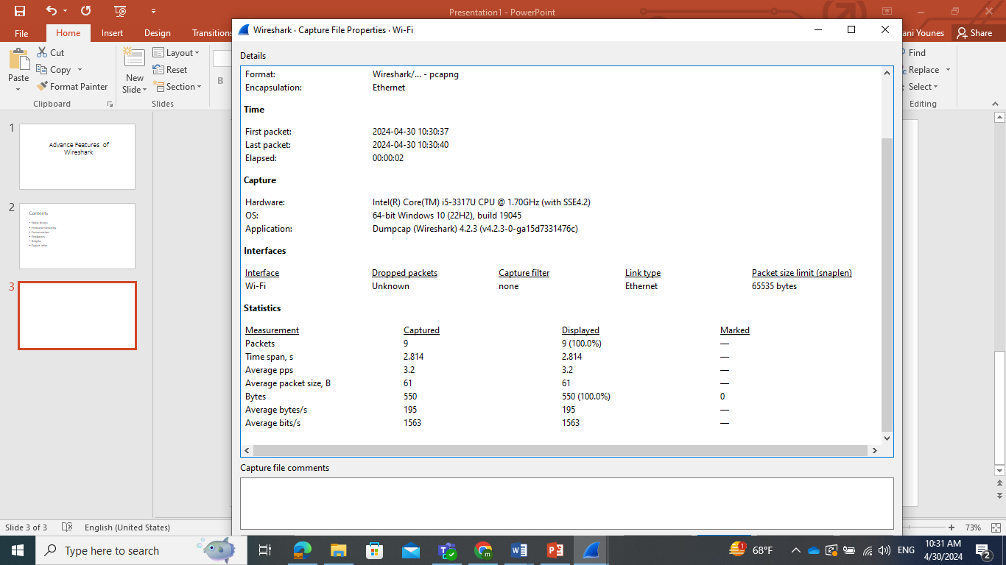
Summary Dialog

Slide 4
Summary Dialog
File: General information, such as the name of the file, location of the file, format used, and encapsulation, is listed under this
• Time: This section will tell you the time when the first and the last packets were captured and the time elapsed (total capture duration)
• Capture: This lists the name of the OS along with the version used and the interface used to dump packets from the live network traffic
• Comments: This shows any comments that the user mentioned for reference
• Interface(s): This lists the details of every interface, using which the traffic is captured
• Display: This section gives statistics regarding any display filter that has been used and the percentage of ignored packets after a filter was applied

Slide 5
Protocol Hierarchy
The Protocol Hierarchy window provides us with an overview regarding distribution of protocols used in the communication process and how to spot unusual activities in your network that do not follow the benchmark as expected.

Slide 6
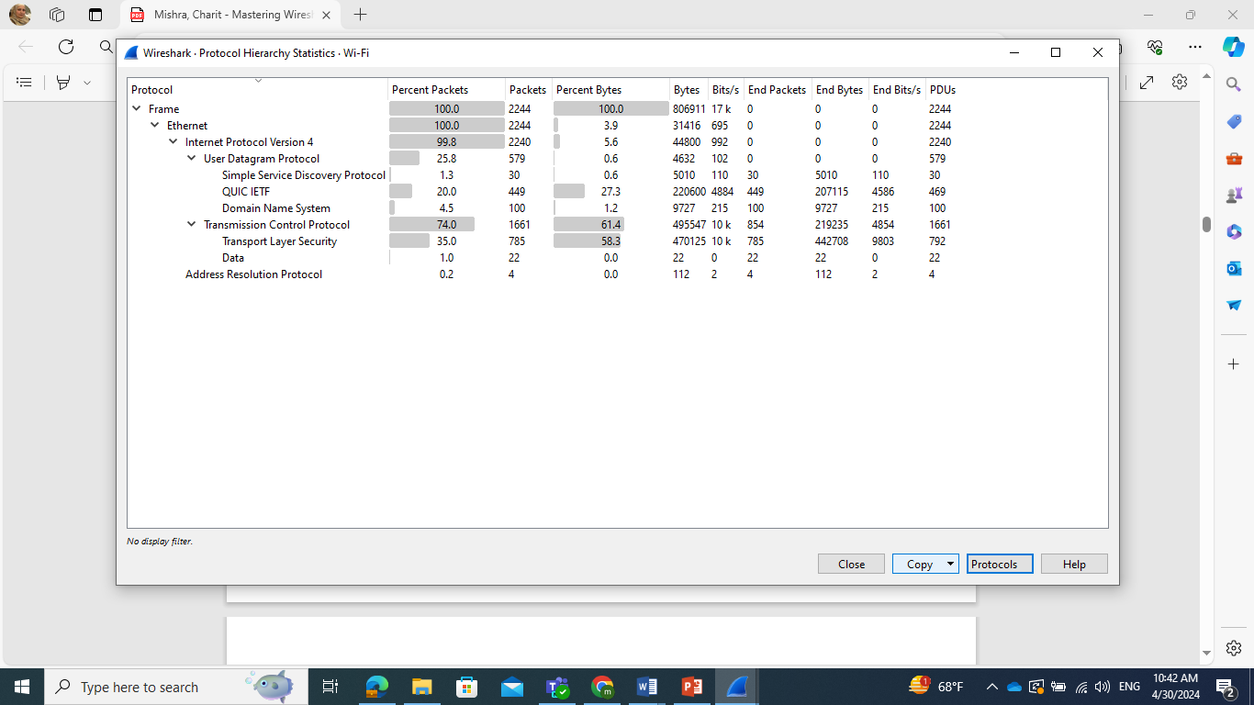
Protocol Hierarchy

Slide 7
Conversations
When two devices are connected on the network, they are supposed to communicate; this is considered normal behavior.
However, suppose you have thousands of devices connected to your network and you want to figure out the most active device that is generating too much traffic, then in that instance, the Conversations window will be quite useful.

Slide 8
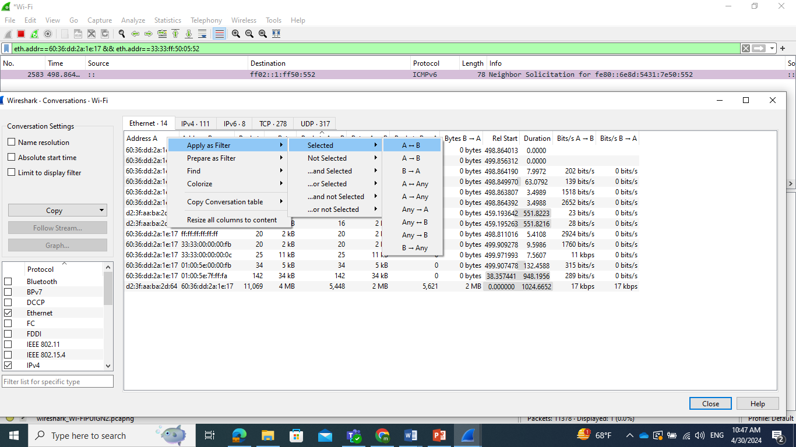
Conversations

Slide 9
Endpoints
Two devices that share data with each other are often referred to as endpoints with reference to Wireshark.
As we have noticed and observed, if a host intends to talk to another host on the network, they would require some form of address to send and receive packets—yes, I am talking about the physical address that every device holds.

Slide 10
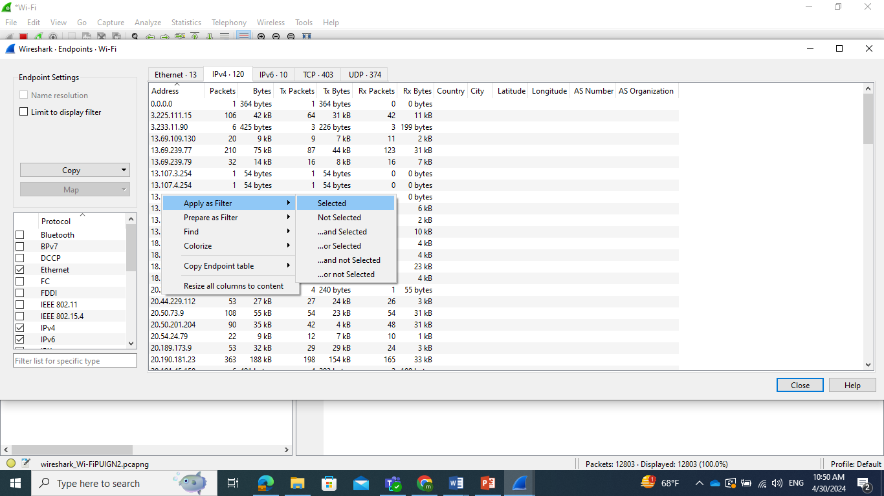
Endpoints

Slide 11
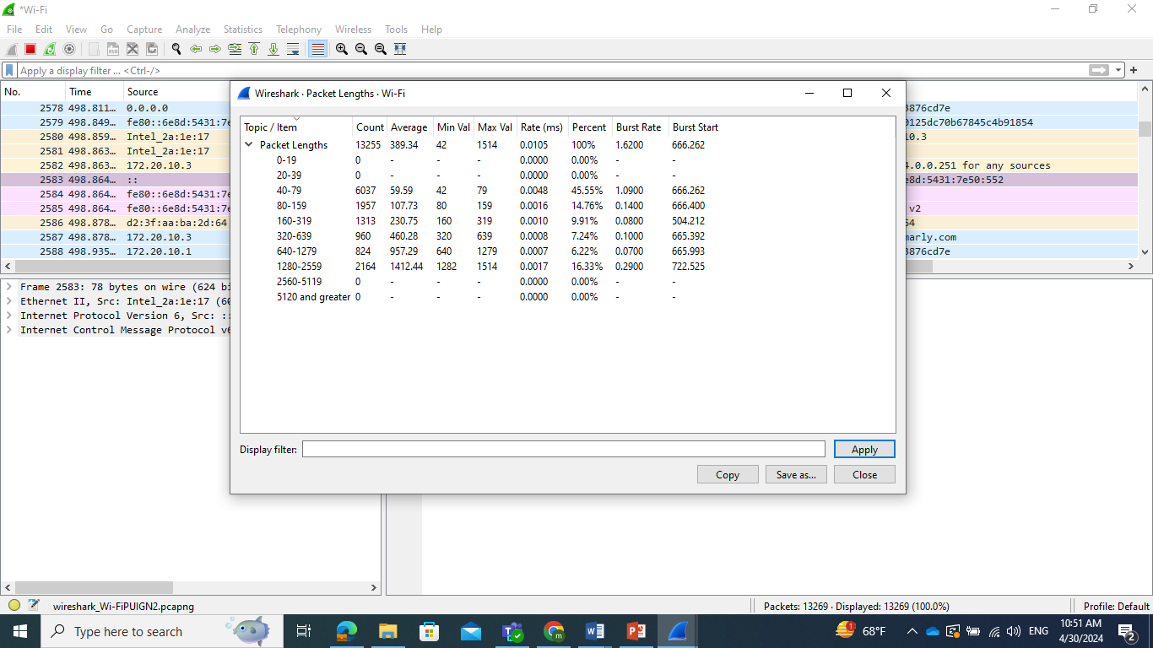
Packet Length

Slide 12
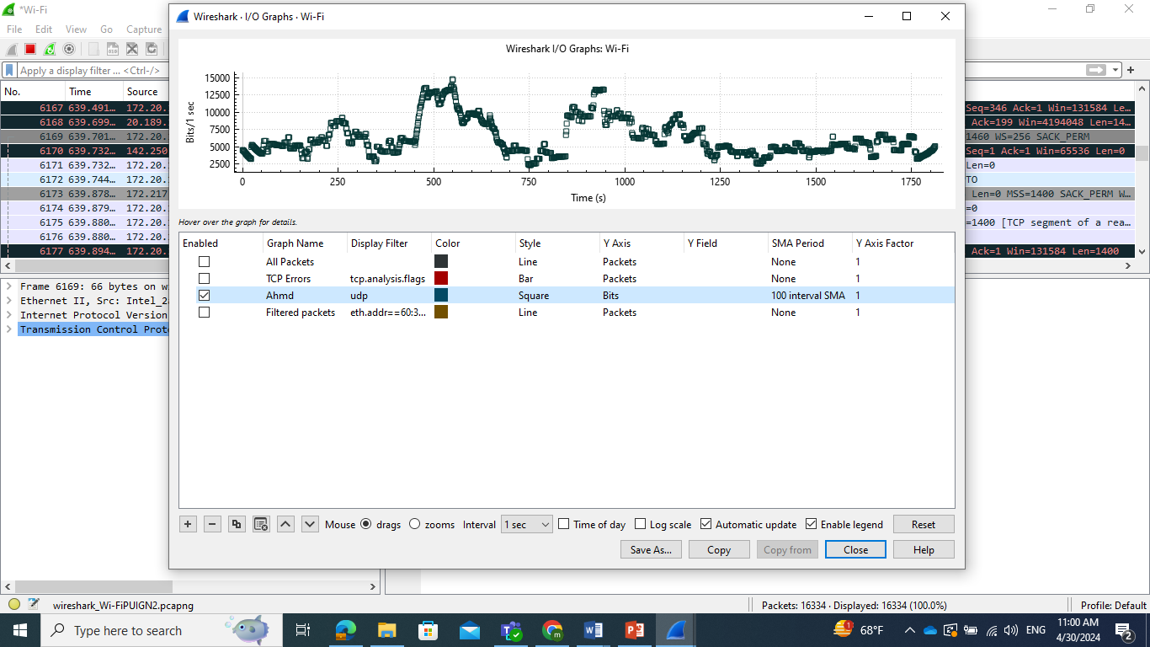
Graphs

Slide 13
Graphs
Name
Filter
Color
Style
X-Axis
Y-Axis
Intervals

Slide 14
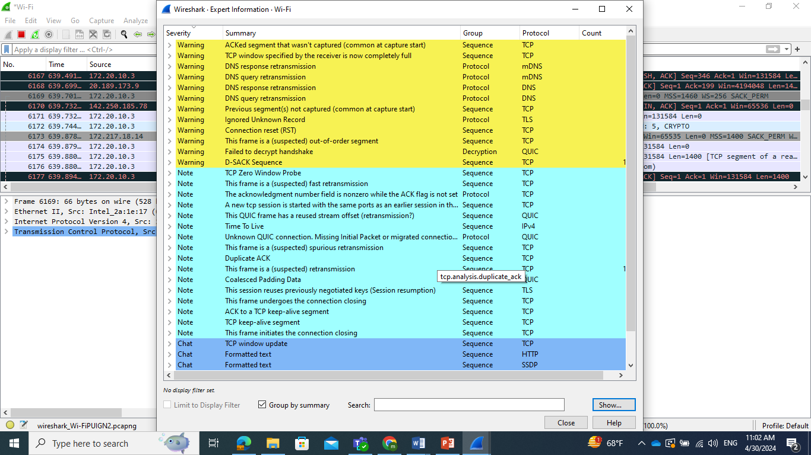
Expert Information

Slide 15
Expert Information
•Red: This indicates errors
• Yellow: This refers to warnings
• Cyan: This refers to a note
• Blue: This refers to chats
• Green: This refers to comments
• Grey: This means non

Slide 16
Practical Questions
Q.1. Create a display filter for FTP packets, and apply the same in a Flow graph. Then, customize it to check the SEQ number and ACKs instead of details.
Q.2. Using a previously captured file, create a Round Time Trip graph and figure out the packet whose RTT is the highest. Then, check the sequence number of that packet and verify its sequence number by comparing it with the graph.
Q.3. Create a Throughput graph between a server and your client. Try to figure out at what time the throughput was at its peak and also try to check the average throughput in bytes/seconds.
Q.4. If you have a requirement to view TCP packets in a raw data form, then which option will you opt for to customize the same window in order to view just the responses from the server side?
Q.5. Create an IO graph and show UDP traffic in red along with general TCP traffic. Then, change the y axis unit to per bytes

Slide 17
Practical Questions

